Slide 1
AstroEngr 331X
Classic Orbital Elements (COE) Definitions
May 2024

Slide 2
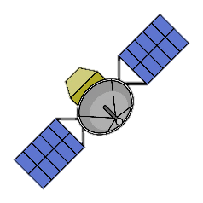
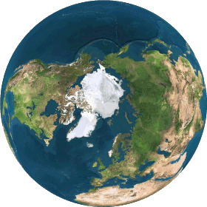



$\overset{⃑}{R}$ and $\overset{⃑}{V}$ Vectors
$$\overset{⃑}{V}$$
$$\overset{⃑}{R}$$

Slide 3


$\overset{⃑}{R}$ and $\overset{⃑}{V}$ Vectors
$$\overset{⃑}{R}$$
$$\overset{⃑}{V}$$

Slide 4




$\overset{⃑}{R}$ and $\overset{⃑}{V}$ Vectors
$$\overset{⃑}{R}$$
$$\overset{⃑}{R}$$
$$\overset{⃑}{V}$$
$$\overset{⃑}{V}$$

Slide 5


$\overset{⃑}{R}$ and $\overset{⃑}{V}$ vs. COEs
$\overset{⃑}{R}$ and $\overset{⃑}{V}$ are ALWAYS changing
COEs are constant (except True Anomaly)

Slide 6
Classic Orbital Elements (COEs)
a –
e –
i –
Ω –
ω –
ν –
Semi-major Axis
Argument of Perigee
Eccentricity
True Anomaly
Inclination
Right Ascension of the Ascending Node (RAAN)

Slide 7
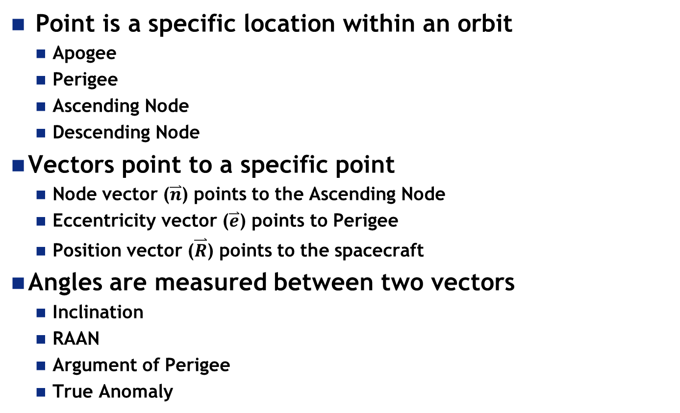
Points, Vectors, & Angles
Point is a specific location within an orbit
Apogee
Perigee
Ascending Node
Descending Node
Vectors point to a specific point
Node vector ($\overset{⃑}{n}$) points to the Ascending Node
Eccentricity vector ($\overset{⃑}{e}$) points to Perigee
Position vector ($\overset{⃑}{R}$) points to the spacecraft
Angles are measured between two vectors
Inclination
RAAN
Argument of Perigee
True Anomaly

Slide 8
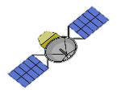
Semi-major Axis (a)
The semi-major axis (a) tells us the SIZE of the orbit.
a
a

Slide 9
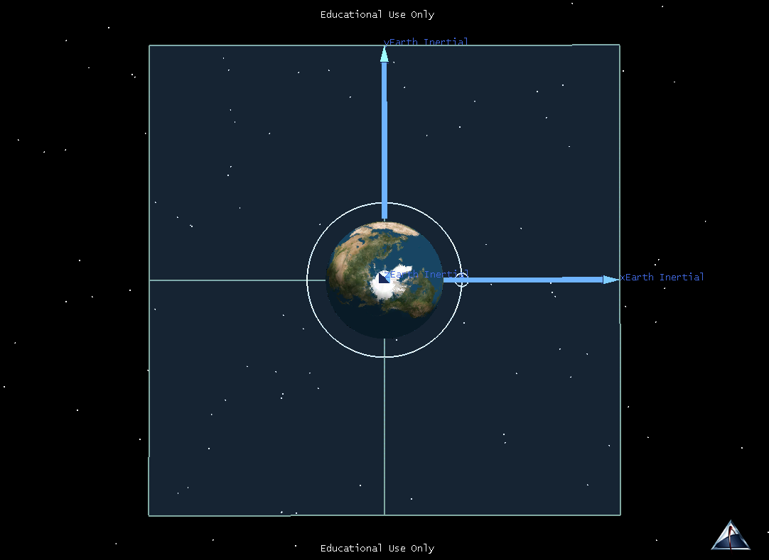

^
j
^
^
k
i

Slide 10
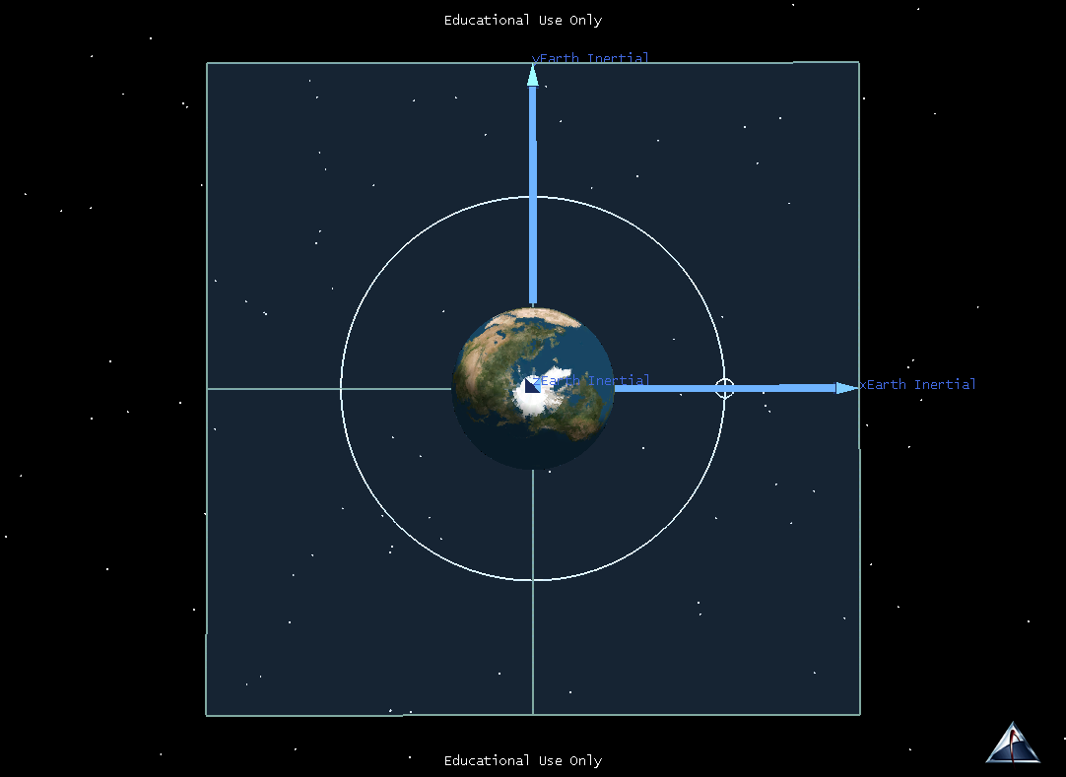
^
j
^
^
k
i

Slide 11
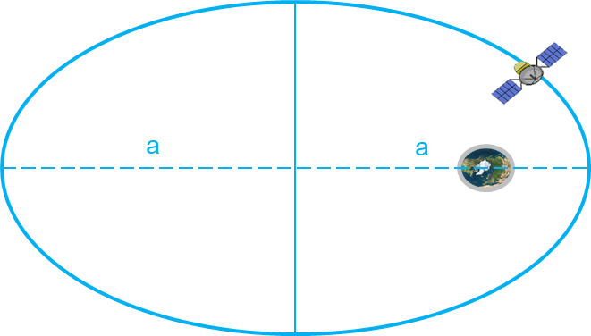
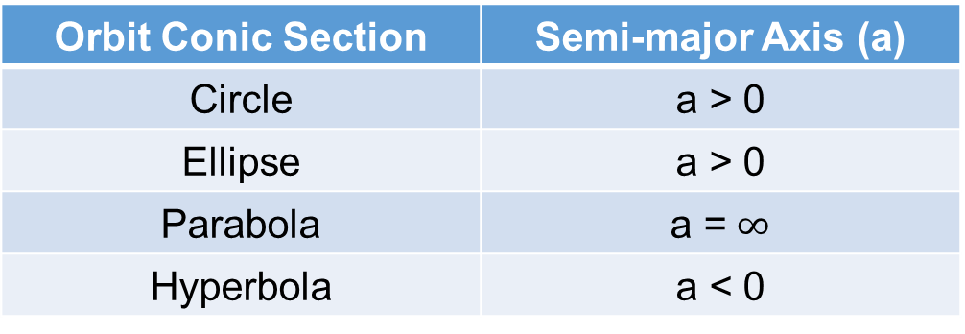



Finding the Semi-major Axis (a)
From Radius of perigee and Radius of Apogee
$\frac{R_{a}+R_{p}}{2}=a$
$R_{p }=a (1−e)$, $R_{a}=a \left(1+e\right)$
From Specific Mechanical Energy:
$ε=−\frac{μ}{2a}$
The sign of the semi major axis helps define the conic section of the orbit:
Apogee: farthest from Earth
Perigee: closest to Earth
$$R_{a}$$
$$R_{p}$$
Orbit Conic Section | Semi-major Axis (a)
Circle | a > 0
Ellipse | a > 0
Parabola | a =$∞$
Hyperbola | a < 0

Slide 12








Orbital Period and Orbital Velocities
The semi-major axis of the orbit can be used to calculate the Orbital Period – how long it takes the satellite to travel all the way around the orbit
$$P=2π\sqrt{\frac{a^{3}}{μ}}$$
The semi-major axis of the orbit, and the satellite’s current location in the orbit can be used to calculate orbital velocity.
General – Valid for any orbit shape
Circular Orbits
$$R$$
$$R$$
$$a$$
For a circular orbit, R=a=constant
$$V=\sqrt{2\left(\frac{μ}{R}−\frac{μ}{2a}\right)}$$
$$V_{circ}=\sqrt{\frac{μ}{R}}$$

Slide 13

Eccentricity
Eccentricity (e) tells us the SHAPE of the orbit.

Slide 14
^
j
^
^
k
i

Slide 15
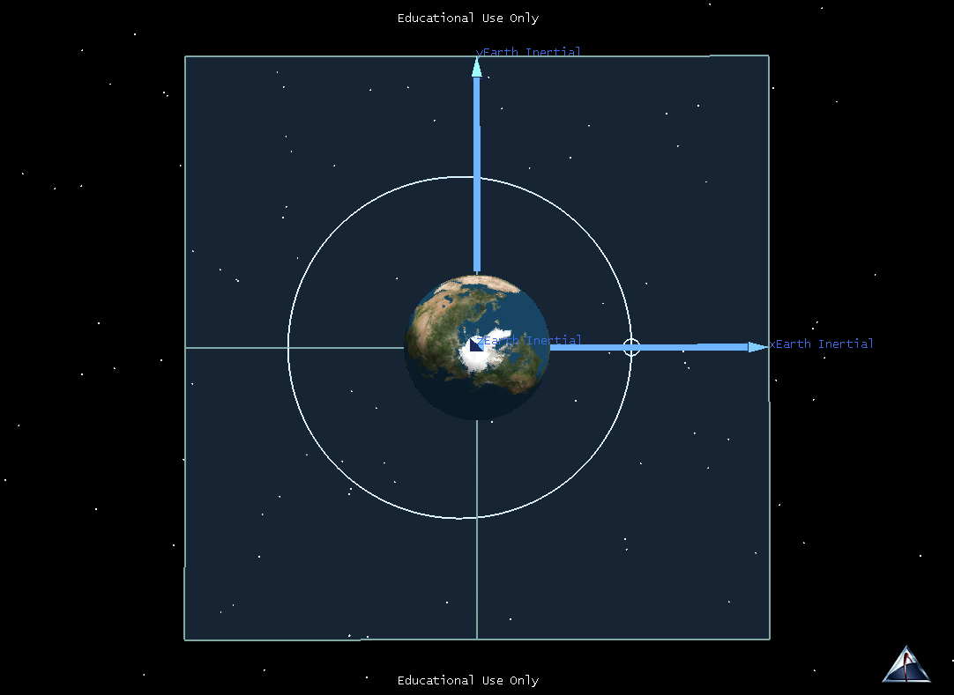
^
j
^
^
k
i

Slide 16

^
j
^
^
k
i

Slide 17
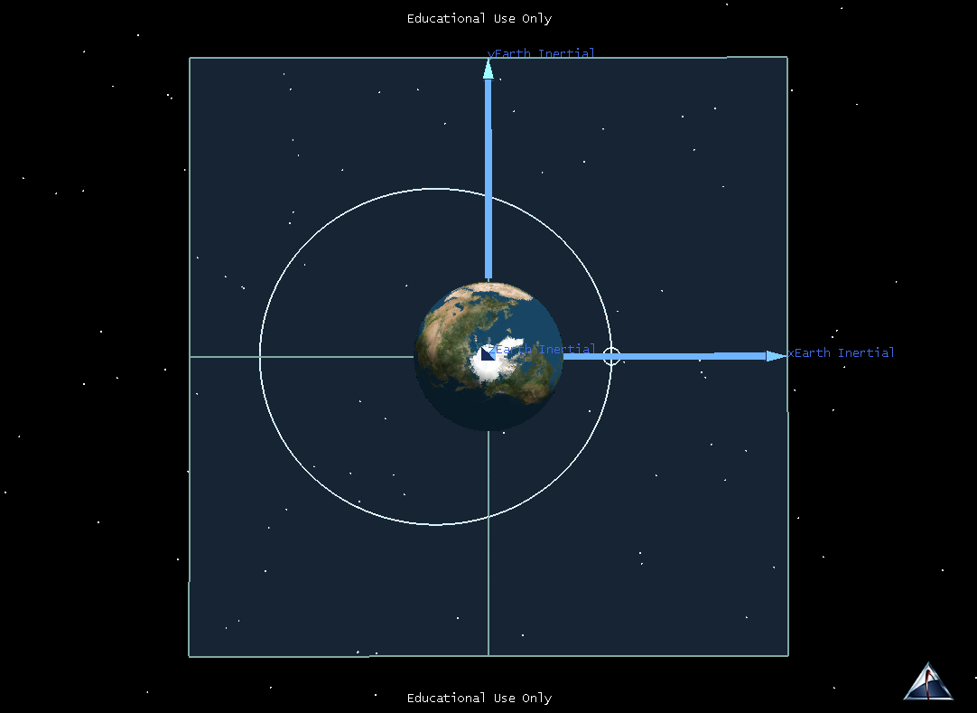
^
j
^
^
k
i

Slide 18

^
j
^
^
k
i

Slide 19
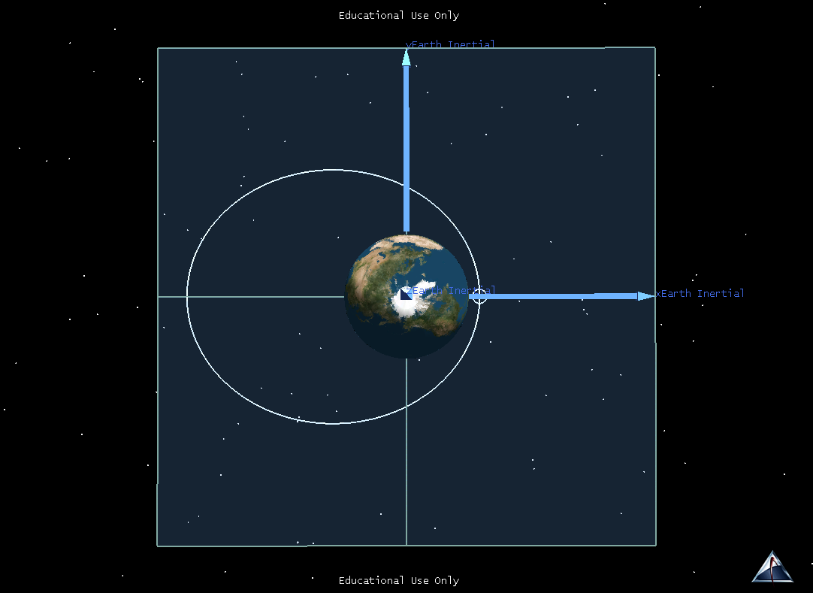
^
j
^
^
k
i

Slide 20
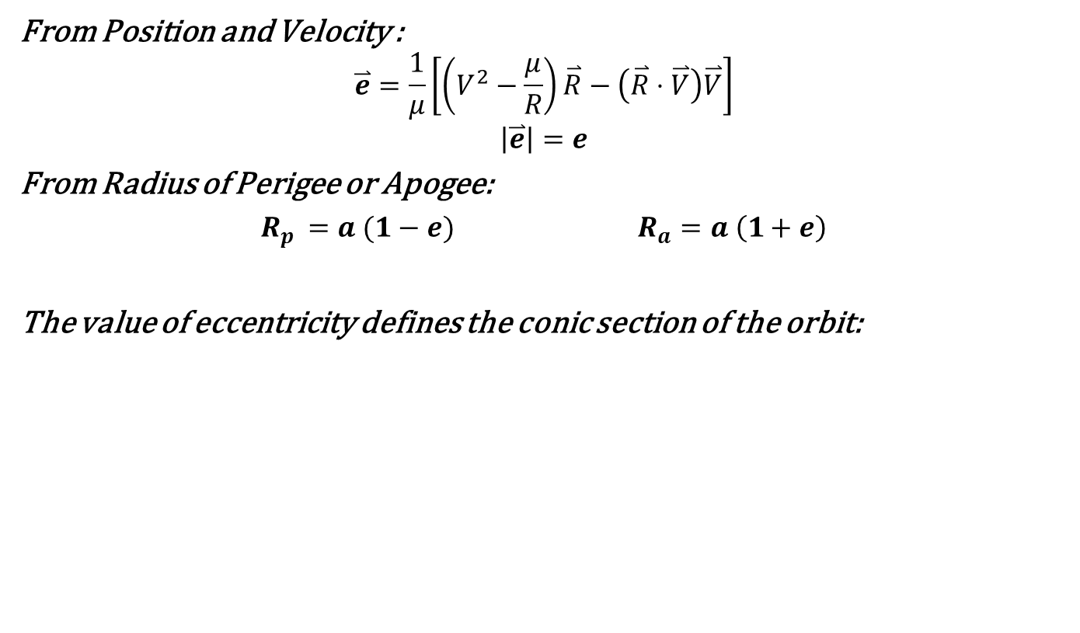
Finding Eccentricity (e)
From Position and Velocity :
$$\overset{⃑}{e}=\frac{1}{μ}\left[\left(V^{2}−\frac{μ}{R}\right)\overset{⃑}{R}−\left(\overset{⃑}{R}⋅\overset{⃑}{V}\right)\overset{⃑}{V}\right]$$
$$\left|\overset{⃑}{e}\right|=e$$
From Radius of Perigee or Apogee:
$R_{p }=a (1−e)$ $R_{a}=a \left(1+e\right)$
The value of eccentricity defines the conic section of the orbit:
Orbit Conic Section | Eccentricity
Circle | e = 0
Ellipse | 0 < e < 1
Parabola | e = 1
Hyperbola | e > 1

Slide 21
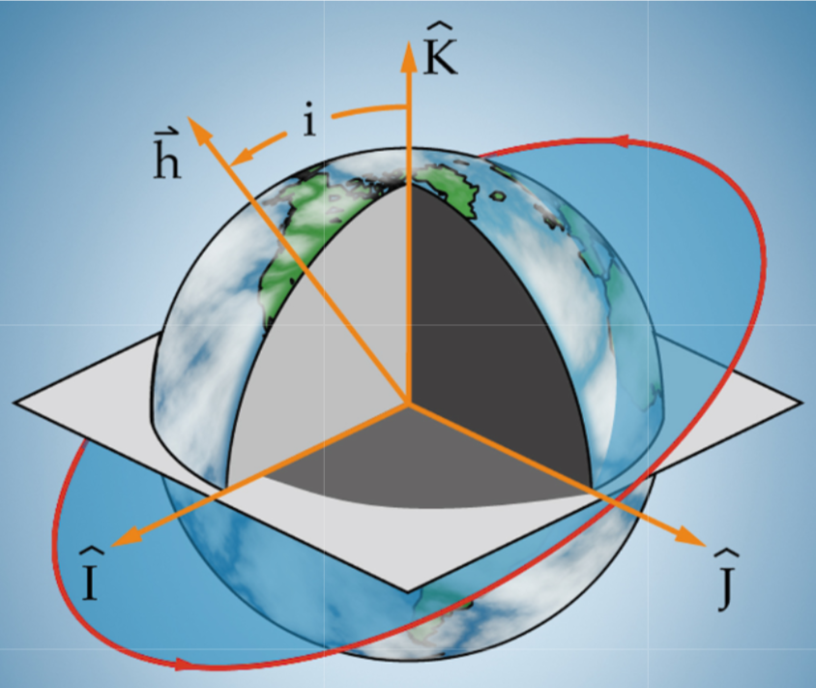
Inclination (i)
Inclination tells us the TILT of the orbit with respect to our fundamental plane.

Slide 22
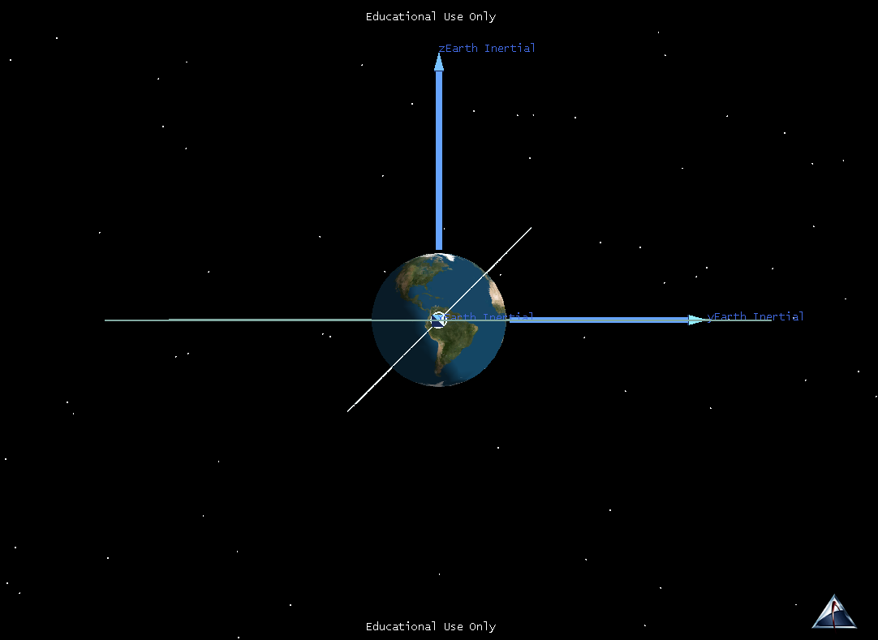
^
k
^
i
^
j

Slide 23

^
k
^
i
^
j

Slide 24
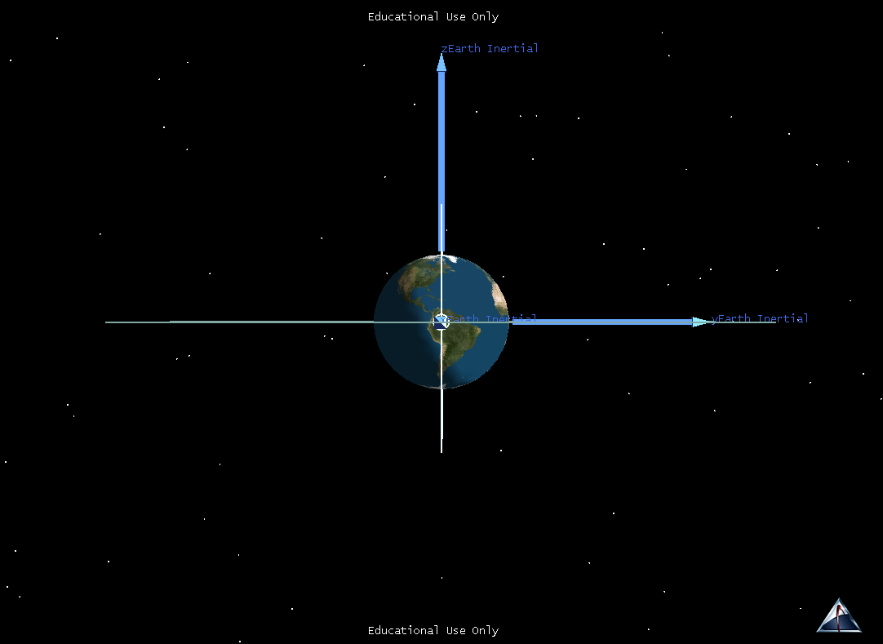
^
k
^
i
^
j

Slide 25

^
k
^
i
^
j

Slide 26
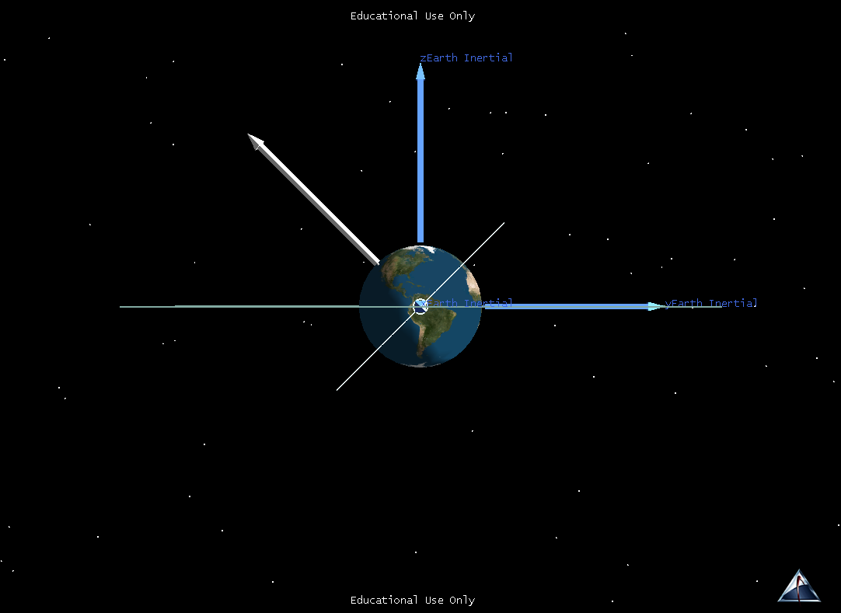
^
k
h
^
i
^
j

Slide 27


Finding Inclination (i)
Measured as the angle between the $\hat{k}$ axis and the specific angular momentum vector ($\overset{⃑}{h}$)
$$\cos{i}=\frac{\hat{k}⋅\overset{⃑}{h}}{kh}$$
Orbit Terminology | Inclination
Equatorial (orbit lies in the equatorial plane) | i = 0° or i = 180°
Prograde (satellite travels generally in the same direction as Earth’s rotation) | 0° ≤ i < 90°
Retrograde (satellite travels generally in opposite direction of Earth’s rotation) | 90° < i ≤ 180°
Polar (satellite passes directly over north and south poles) | i = 90°

Slide 28
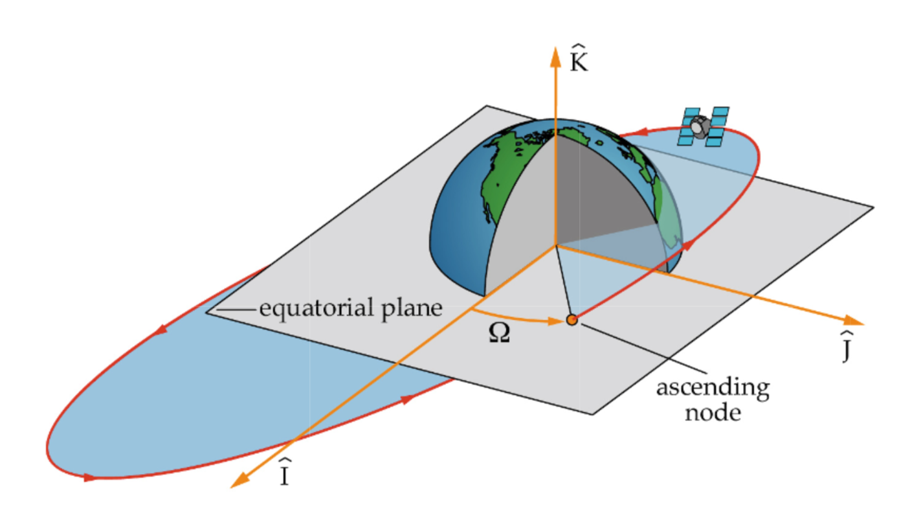

Right Ascension of the Ascending Node (RAAN)
RAAN tells us the SWIVEL of the orbit with respect to the $\hat{i}$ axis.

Slide 29
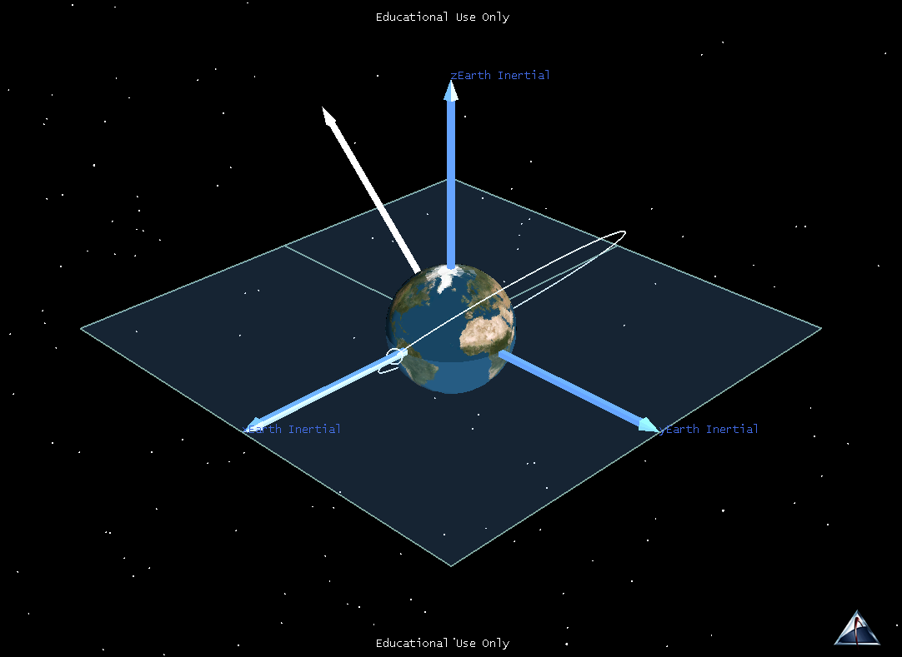
^
k
h
^
^
i
j

Slide 30
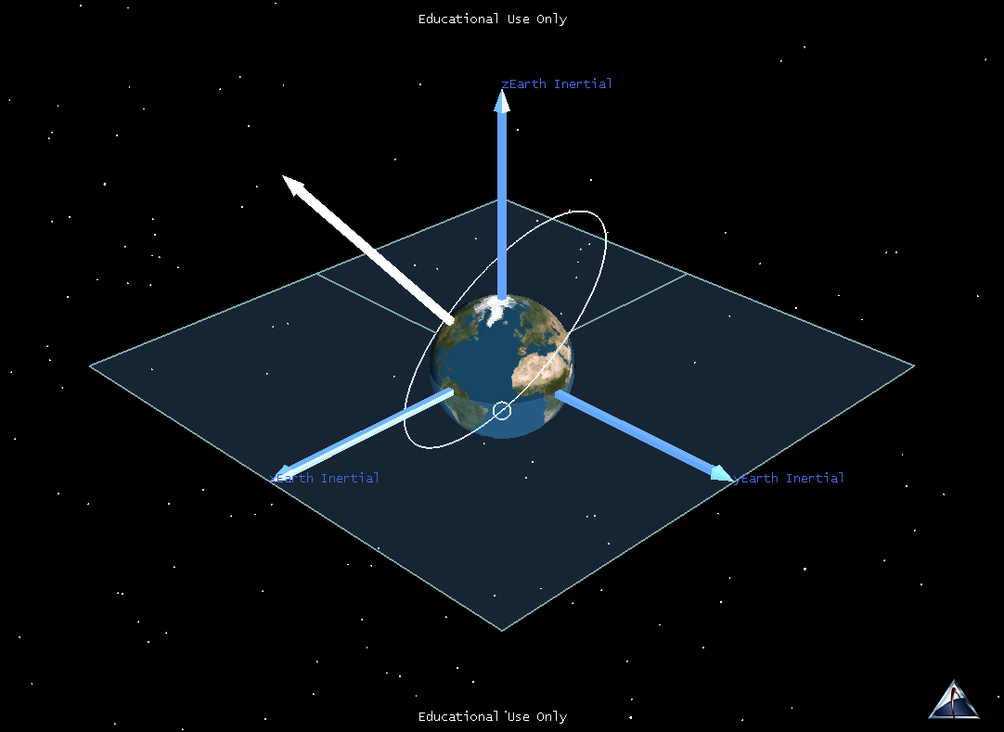
^
k
h
^
^
i
j

Slide 31
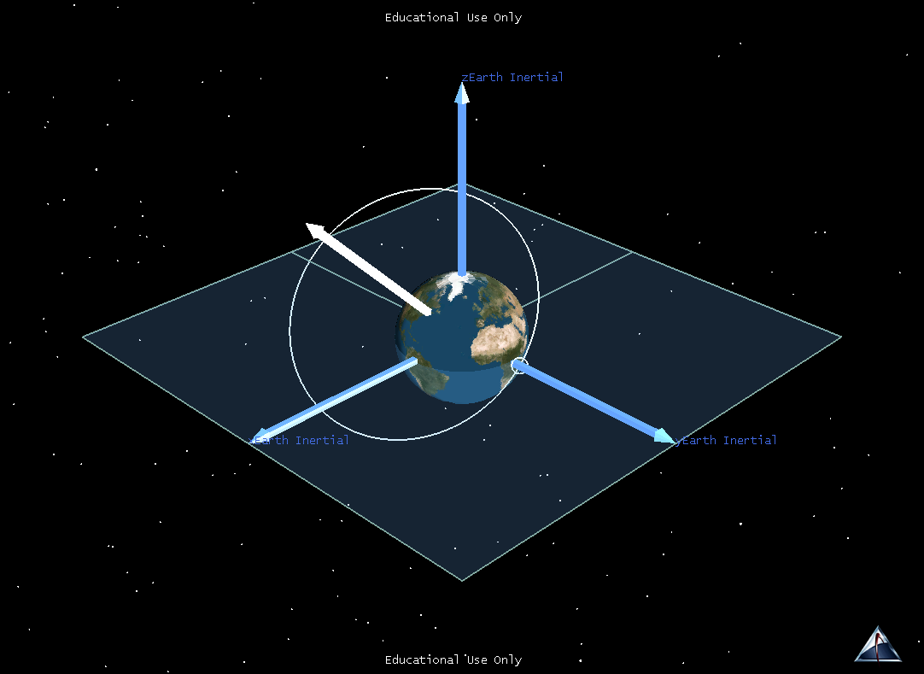
^
k
h
^
^
i
j

Slide 32
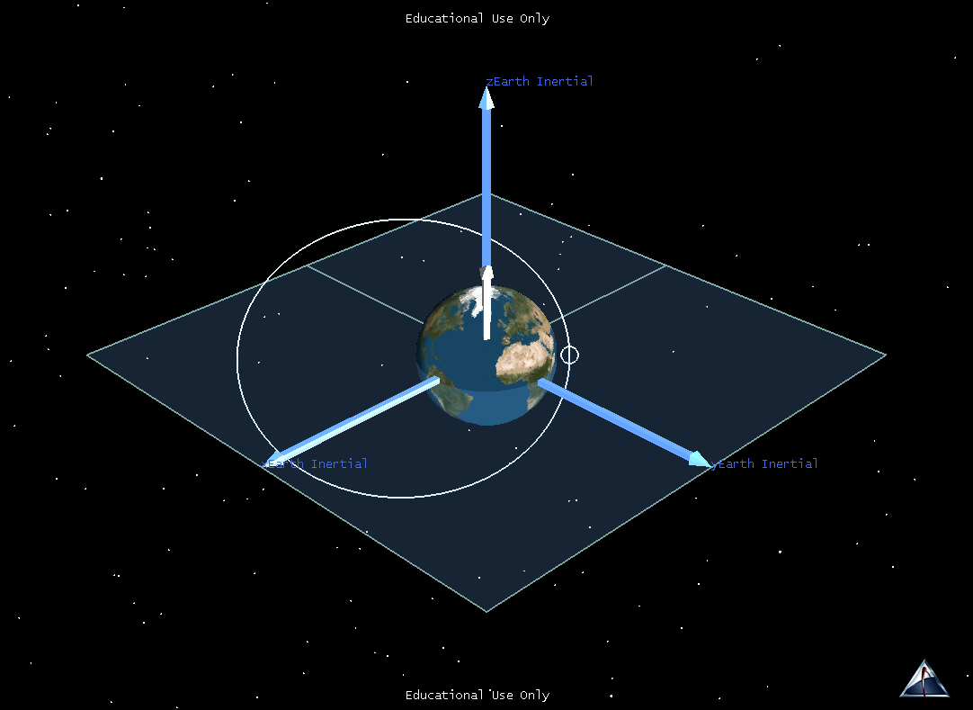
^
k
h
^
^
i
j

Slide 33
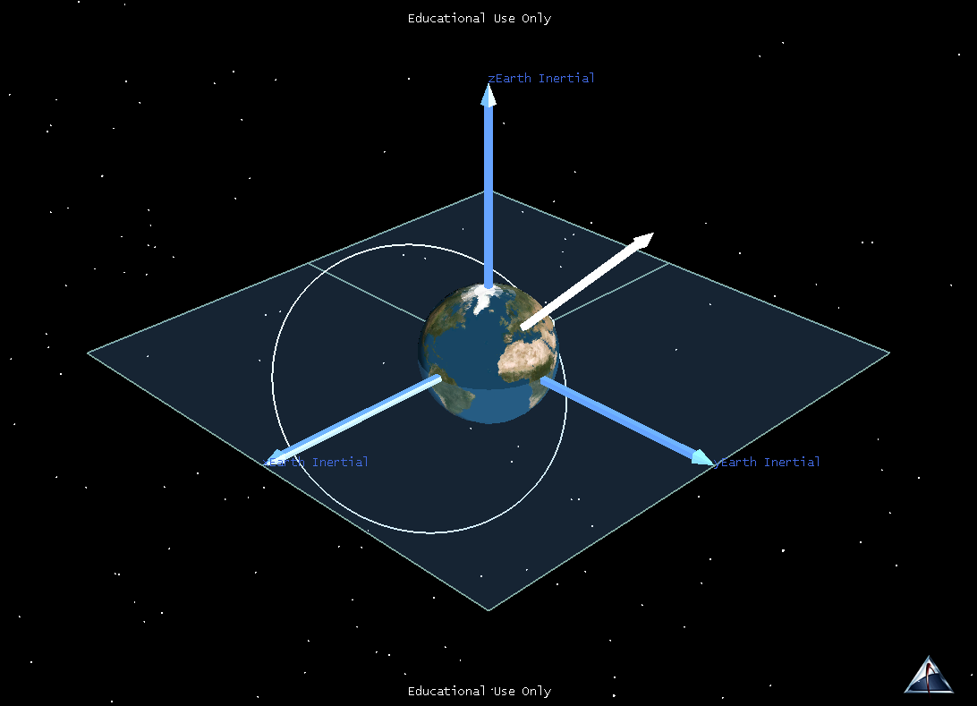
^
k
h
^
^
i
j

Slide 34
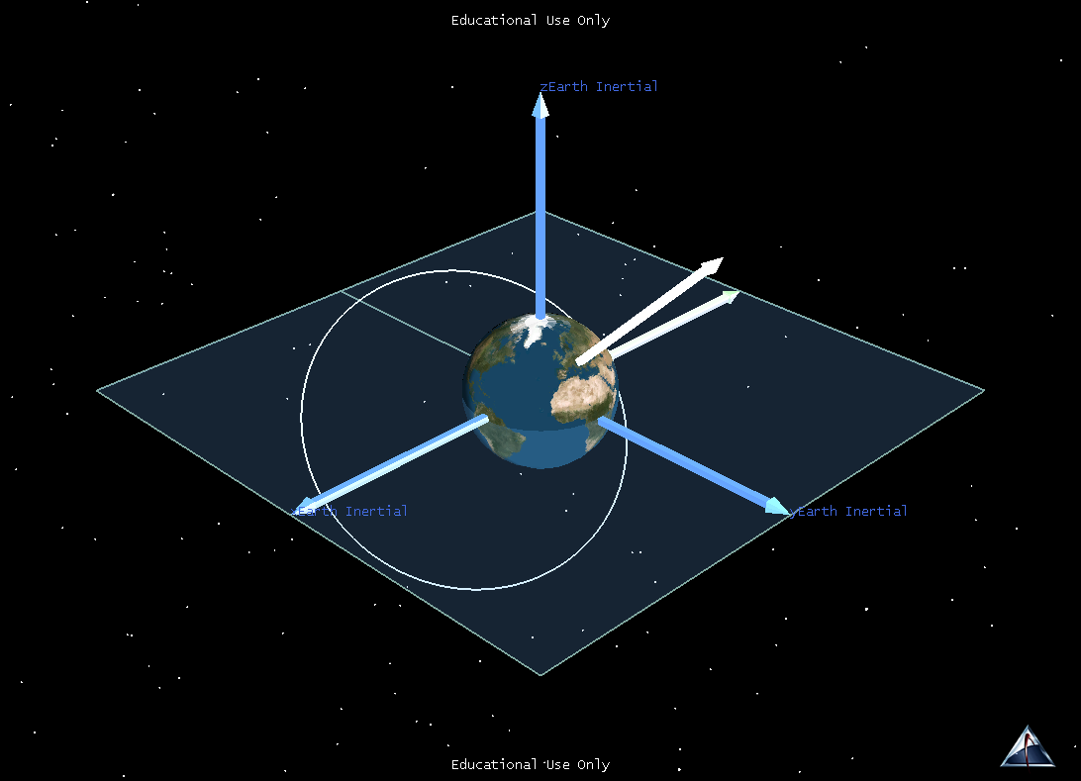
^
k
h
n
^
^
i
j

Slide 35
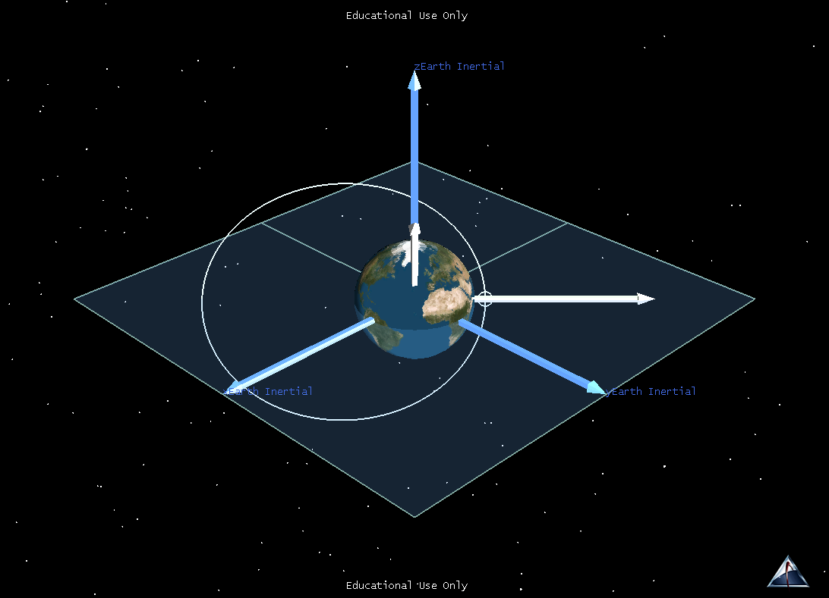
^
k
h
n
^
^
i
j

Slide 36
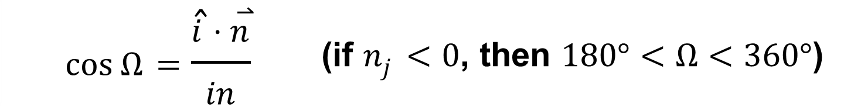
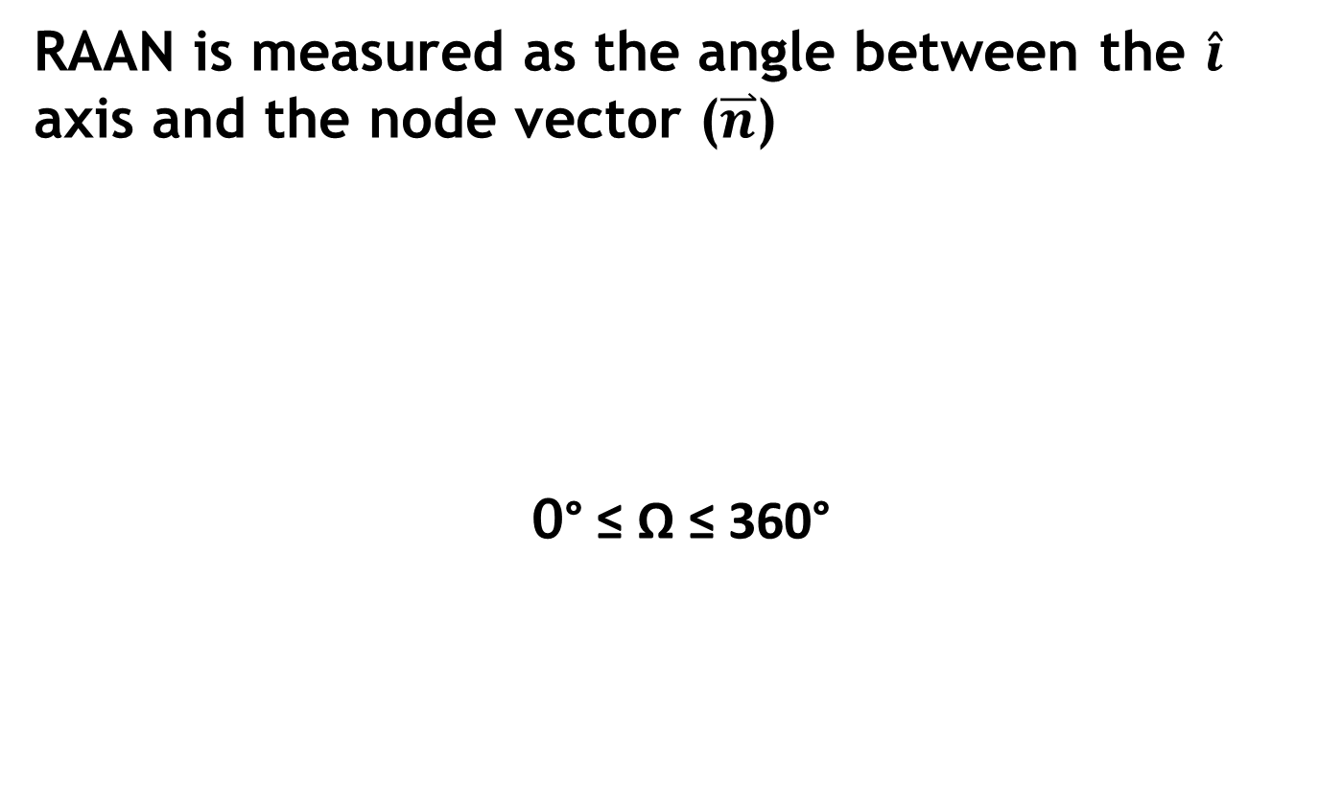
Finding RAAN (Ω)
RAAN is measured as the angle between the $\hat{i}$ axis and the node vector ($\overset{⃑}{n}$)
0° ≤ Ω ≤ 360°
$$\cos{Ω}=\frac{\hat{i}⋅\overset{⃑}{n}}{in}$$ | (if $n_{j}<0$, then $180°<Ω<360°$)

Slide 37
Argument of Perigee (ω)
Argument of Perigee tells us the location of Perigee with respect to the Ascending Node.

Slide 38
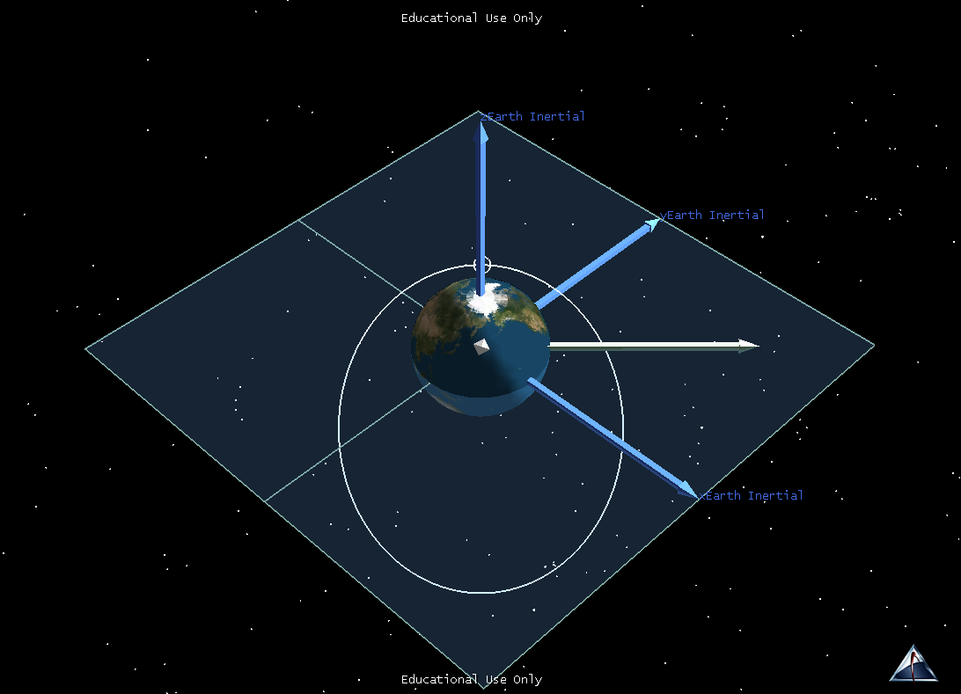
^
k
^
j
h
n
^
i

Slide 39
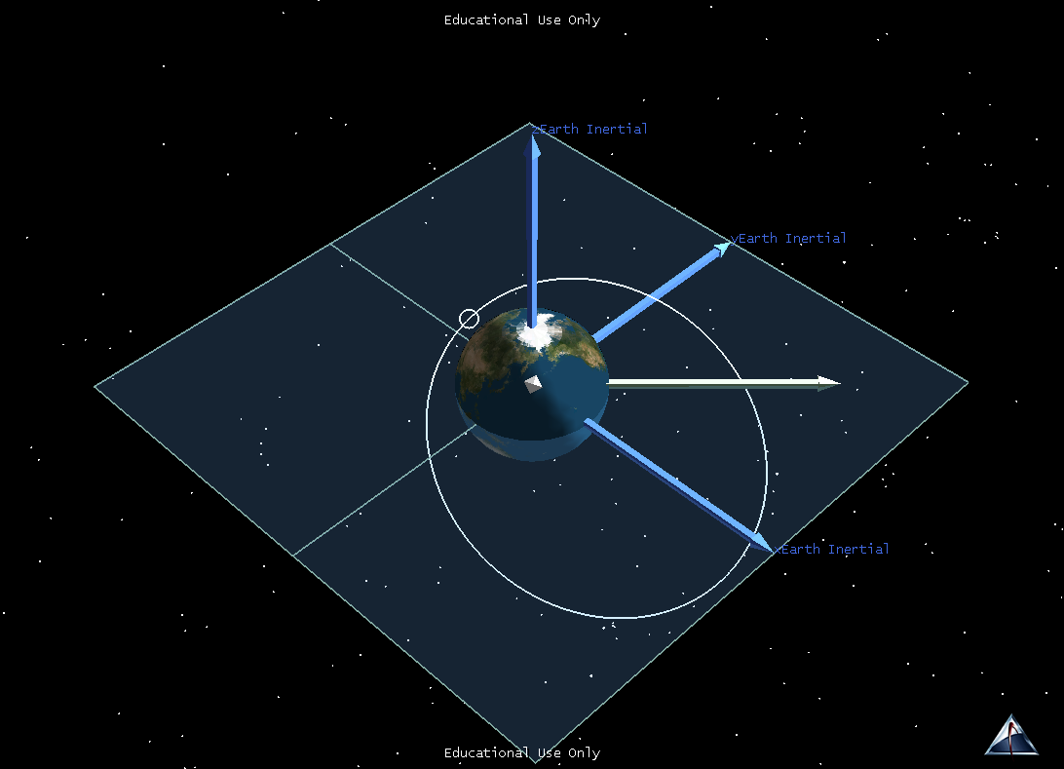
^
k
^
j
h
n
^
i

Slide 40
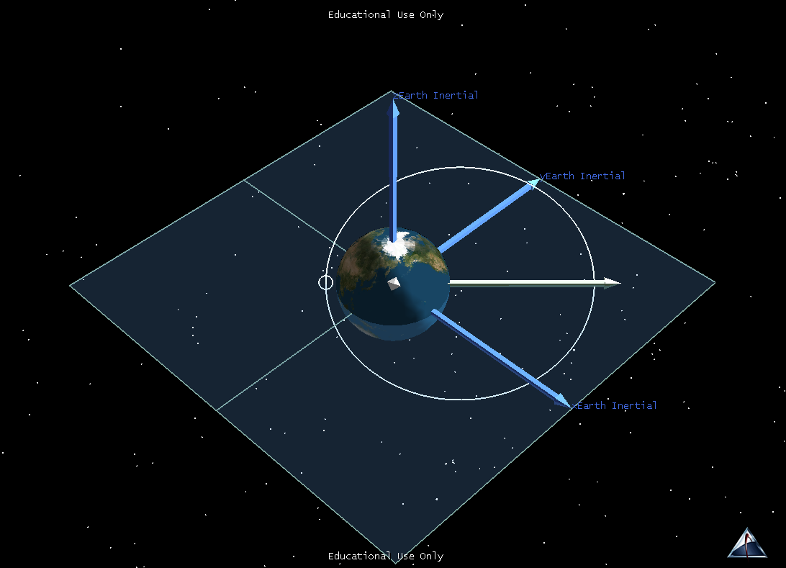
^
k
^
j
h
n
^
i

Slide 41
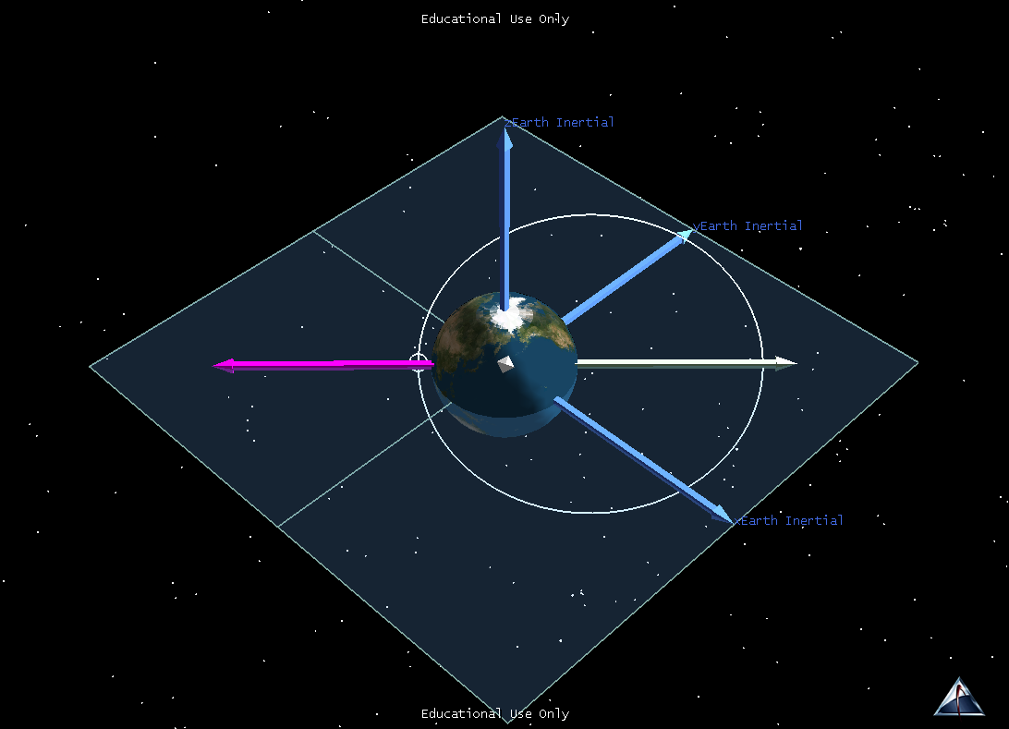
^
k
^
j
e
h
n
^
i

Slide 42
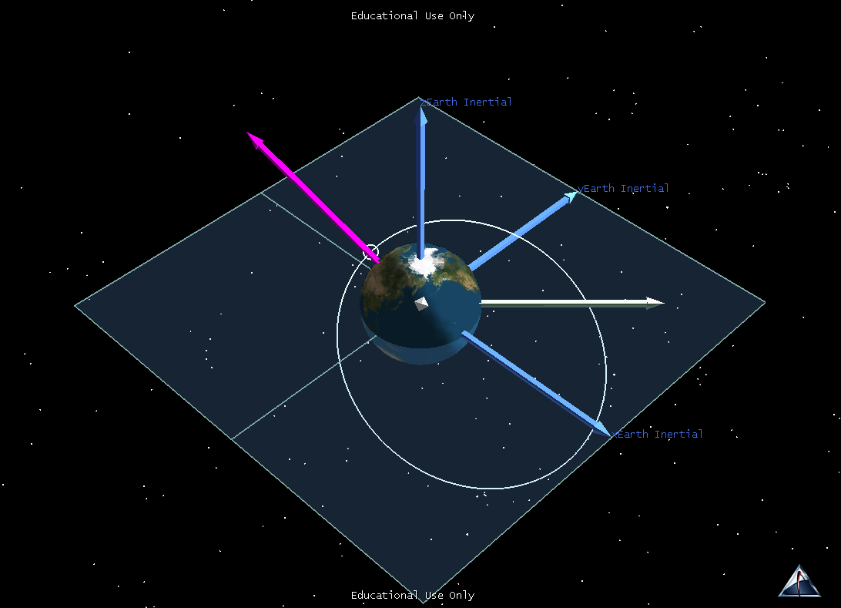
^
k
e
^
j
h
n
^
i

Slide 43
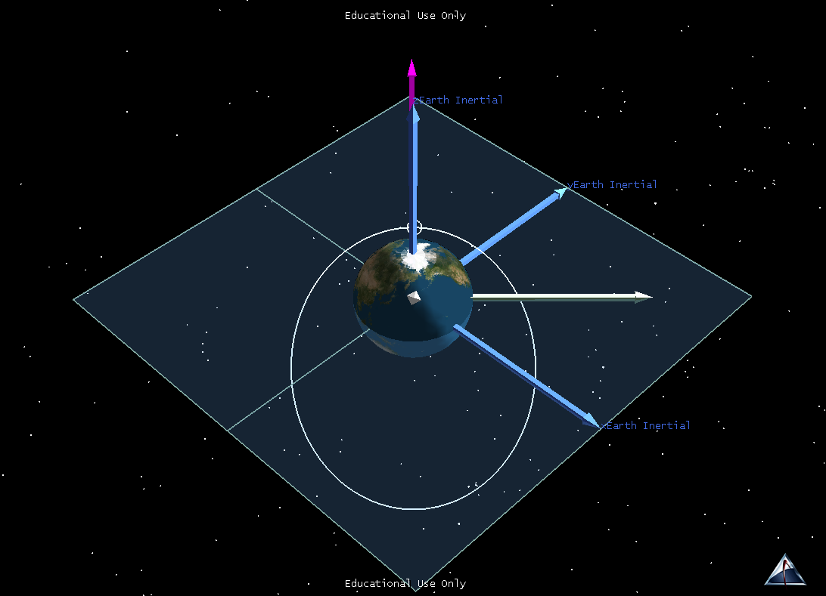
e
^
k
^
j
h
n
^
i

Slide 44
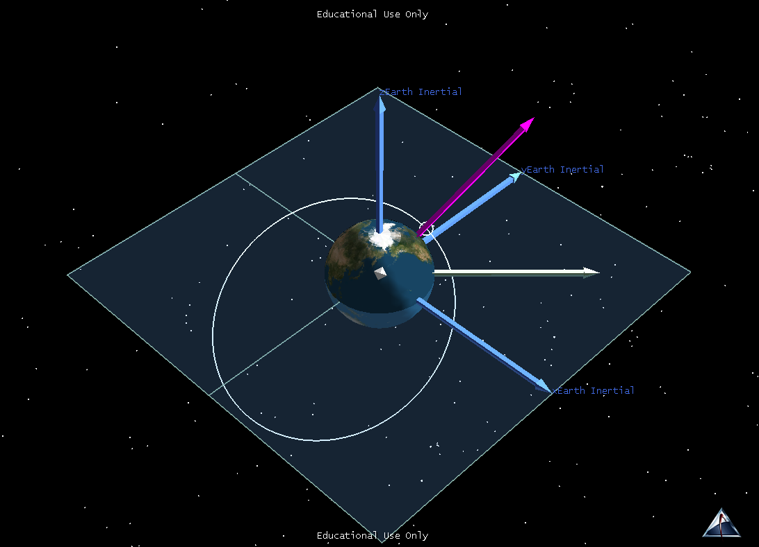
^
k
e
^
j
h
n
^
i

Slide 45
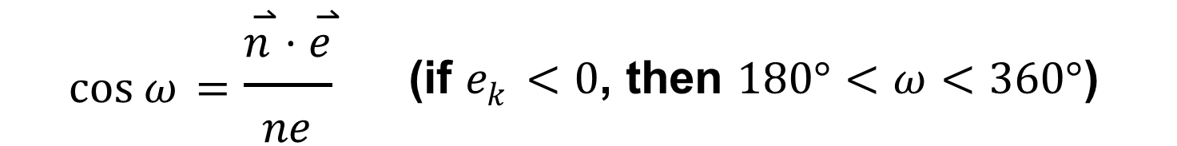

Finding Argument of Perigee (ω)
Measured as the angle between the node vector ($\overset{⃑}{n}$) and the eccentricity vector ($\overset{⃑}{e}$)
$$\cos{ω}=\frac{\overset{⃑}{n}⋅\overset{⃑}{e}}{ne}$$ | (if $e_{k}<0$, then $180°<ω<360°$)
0° ≤ ω ≤ 360°

Slide 46
True Anomaly (ν)
True Anomaly gives us the spacecraft location with respect to Perigee.

Slide 47
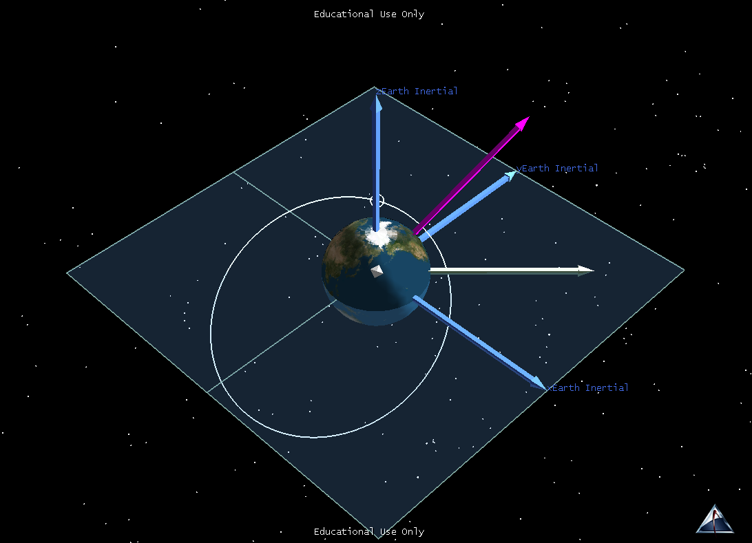
^
k
e
^
j
h
n
^
i

Slide 48
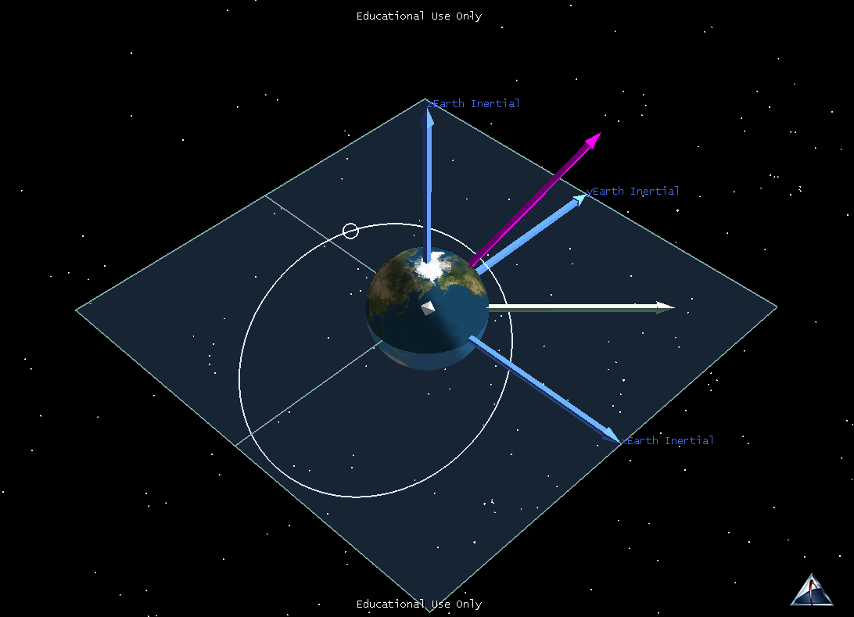
^
k
e
^
j
h
n
^
i

Slide 49
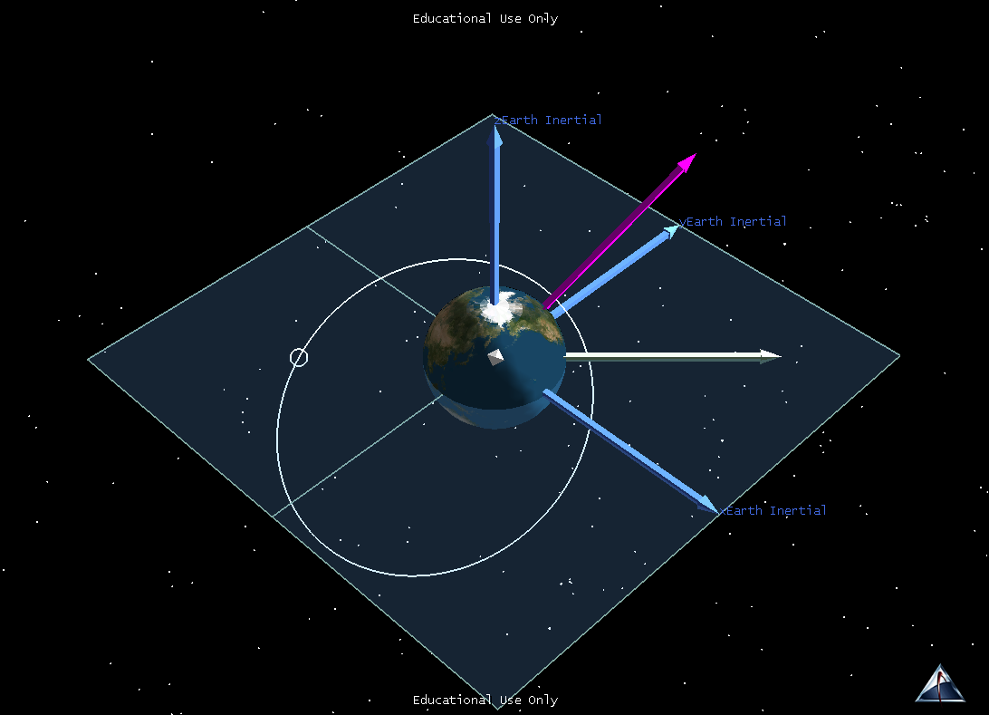
^
k
e
^
j
h
n
^
i

Slide 50

^
k
e
^
j
h
n
^
i

Slide 51

^
k
e
^
j
h
n
^
i

Slide 52

^
k
e
^
j
h
n
^
i

Slide 53
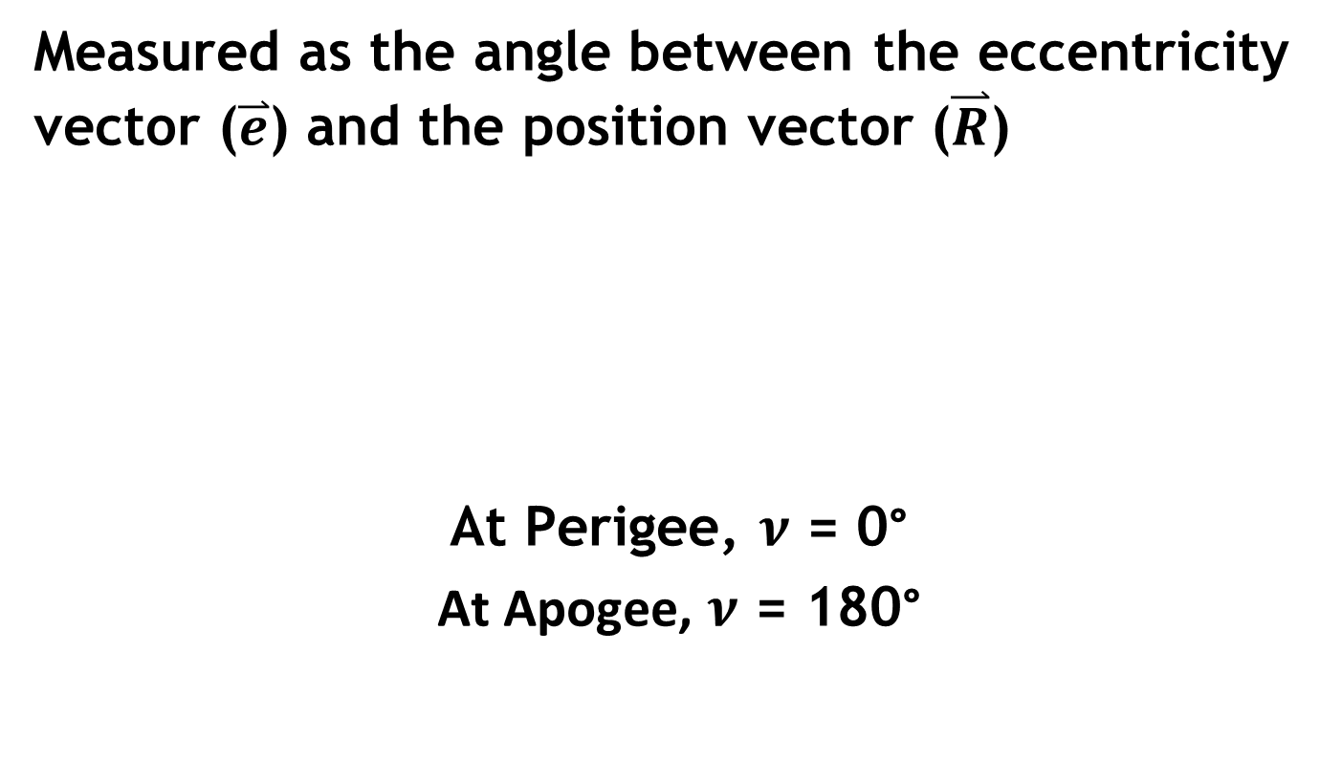
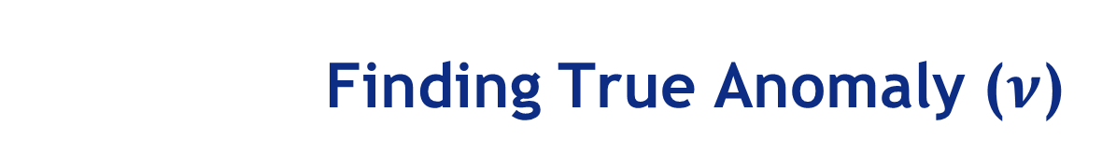
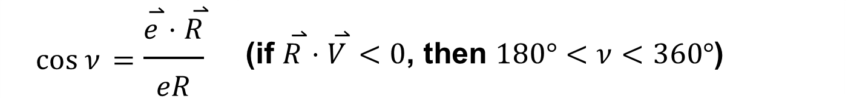
Finding True Anomaly ($ν$)
Measured as the angle between the eccentricity vector ($\overset{⃑}{e}$) and the position vector ($\overset{⃑}{R}$)
At Perigee, $ν$ = 0°
At Apogee, $ν$ = 180°
$$\cos{ν}=\frac{\overset{⃑}{e}⋅\overset{⃑}{R}}{eR}$$ | (if $\overset{⃑}{R}⋅\overset{⃑}{V}<0$, then $180°<ν<360°$)

Slide 54
$\overset{⃑}{R}$ and $\overset{⃑}{V}$ vs. COEs
$\overset{⃑}{R}$ and $\overset{⃑}{V}$ are ALWAYS changing
COEs are constant (except True Anomaly)
a – size of orbit
e – shape of orbit
i – tilt of orbital plane wrt the equator
Ω – location of ascending node wrt the vernal equinox direction
ω – location of perigee wrt ascending node
ν – location of satellite wrt perigee
*wrt = with respect to

Slide 55
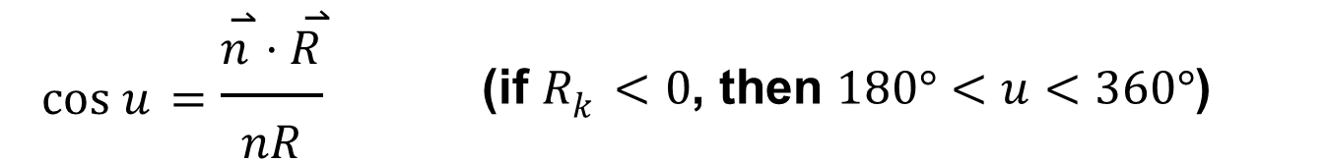

Special Cases #1
Circular Orbit
e = 0 and there is no PERIGEE; therefore we cannot calculate anything with $\overset{⃑}{e}$
Argument of Perigee and True Anomaly are UNDEFINED
Spacecraft location is given by Argument of Latitude (u)
$$\cos{u}=\frac{\overset{⃑}{n}⋅\overset{⃑}{R}}{nR}$$ | (if $R_{k}<0$, then $180°<u<360°$)

Slide 56
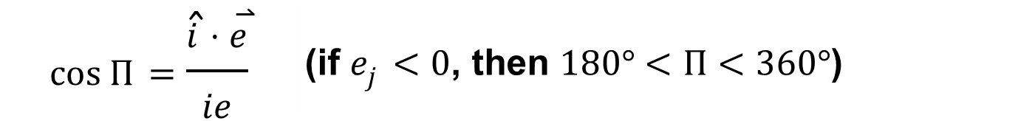

Special Cases #2
Equatorial Orbit
No ascending node; therefore no node vector ($\overset{⃑}{n}$)
RAAN and Argument of Perigee are UNDEFINED
Perigee location is given by Longitude of Perigee (Π)
$$\cos{Π}=\frac{\hat{i}⋅\overset{⃑}{e}}{ie}$$ | (if $e_{j}<0$, then $180°<Π<360°$)

Slide 57


Special Cases #3
Circular, Equatorial Orbit
e = 0 and there is no PERIGEE; therefore we cannot calculate anything with $\overset{⃑}{e}$
No ascending node; therefore no node vector ($\overset{⃑}{n}$)
RAAN, Argument of Perigee, and True Anomaly are UNDEFINED
Spacecraft location is given by True Longitude ($ℓ$)
$$\cos{𝓁}=\frac{\hat{i}⋅\overset{⃑}{R}}{iR}$$ | (if $R_{j}<0$, then $180°<𝓁<360°$)

Slide 58


Constants of Orbital Motion
Specific Mechanical Energy(ε)
$$E=\frac{1}{2}mV^{2} − \frac{μm}{R}$$
$$ε=\frac{V^{2}}{2} − \frac{μ}{R}$$
Specific Angular Momentum ($\overset{⃑}{h}$)
$$\overset{⃑}{H}=\overset{⃑}{R} x m\overset{⃑}{V}$$
$$\overset{⃑}{h}=\overset{⃑}{R} x \overset{⃑}{V}$$

Slide 59

Summary
Defined the six COEs and their associated vectors
We prefer COEs over R and V because…
R and V are always changing
COEs are constant (except True Anomaly)
Constants of orbital motion are based on R & V
But…even though R & V are always changing… $ε$ & $\overset{⃑}{h}$ are CONSTANT!!!

